Slide 1
AWS Technology Overview

Slide 2

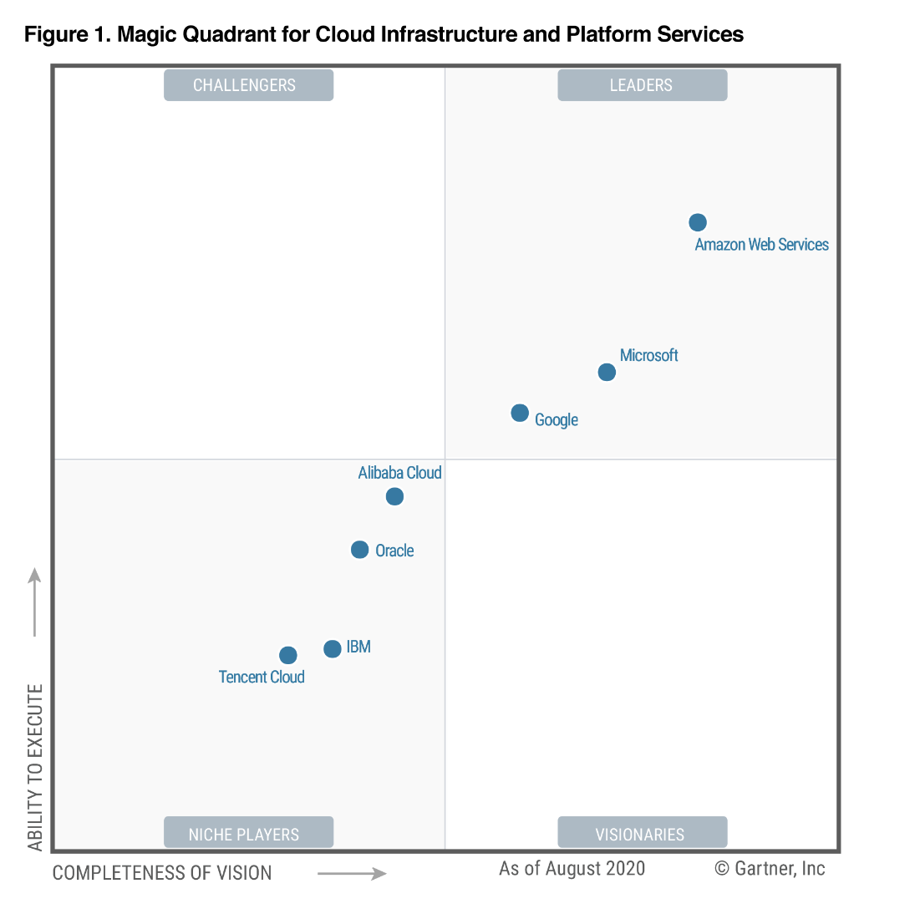

AWS Recognized as a Cloud Leader for the 10th Consecutive Year
Gartner, Magic Quadrant for Cloud Infrastructure & Platform Services, Raj Bala, Bob Gill, Dennis Smith, David Wright, Kevin Ji, 1 September 2020. Gartner does not endorse any vendor, product or service depicted in its research publications, and does not advise technology users to select only those vendors with the highest ratings. Gartner research publications consist of the opinions of Gartner's research organization and should not be construed as statements of fact. Gartner disclaims all warranties, expressed or implied, with respect to this research, including any warranties of merchantability or fitness for a particular purpose. The Gartner logo is a trademark and service mark of Gartner, Inc., and/or its affiliates, and is used herein with permission. All rights reserved.
Notes:
2019 Gartner IaaS MQ Slide – READ & REMOVE BEFORE USING
Gartner has approved this slide for “limited audience” use only (private customer engagements such as meetings, RFI/RFP). Any public presentation (Summits, events, keynotes, etc) requires individual approval from Gartner. No exceptions. Contact aws-sales-ar@amazon.com to start the approval process.
Highspot has the only Gartner MQ slide pre-approved for sales meeting and proposal use
Absolutely no changes are permitted to the slide (no exceptions granted)
Do not add an AWS, Gartner or “other” logo or background to slides
You cannot circle dots & You cannot show year-over-year comparisons of MQs
No Gartner quotes can be added
Any changes to the slide require permission from Gartner
Send the complete document or presentation with proper attribution to aws-sales-ar@amazon.com
Follow these policies: http://www.gartner.com/technology/about/policies/copyright.jsp
[TALKING POINTS]
Every product planning session at AWS revolves around customers. We do our best to listen and to learn, and to use what we hear to build the roadmaps for future development.
We believe that this customer-driven innovation has helped us to secure the top-right corner of the Leaders quadrant in Gartner’s Magic Quadrant for Cloud Infrastructure as a Service (IaaS) for the 9th consecutive year, earning highest placement for ability to execute and furthest for completeness of vision.
1/ It’s this innovation and the strength of our customer based which leads to AWS continuing to be the market leader in the cloud.
2/ Gartner’s Infrastructure as a Service Magic Quadrant is the longest running Magic Quadrant.
3/ And AWS is the longest running leader in the cloud with the 10th consecutive leader in the cloud.

Slide 3
Topics
AWS Global Infrastructure
Amazon Virtual Private Cloud (VPC)
Security groups
Compute Services
Amazon Elastic Compute Cloud (EC2)
Amazon Elastic Block Store (EBS)
Amazon Simple Storage Service (S3)

Slide 4
AWS Global Infrastructure

Slide 5
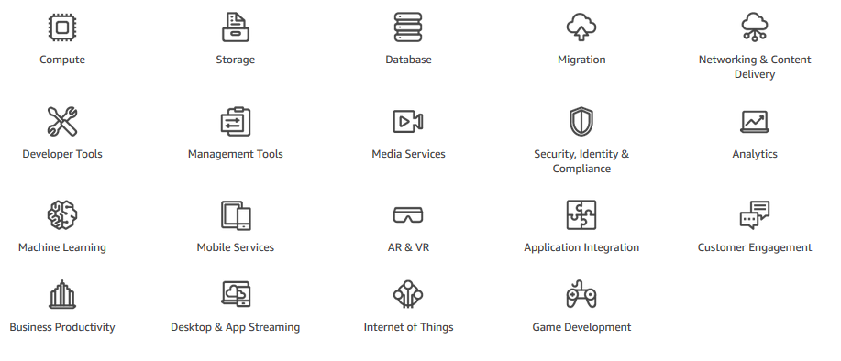
Introduction to Services and Categories
Notes:
In this module you will cover the services and categories for AWS and a little bit about AWS documentation. AWS offers a broad set of global cloud based products that can be used as building blocks for common cloud architectures. Each product offers a variety of services. Some of the categories discussed in this module include Compute, Storage, Database, Networking & Content Delivery and Security, Identity & Compliance. Let’s take a moment to look at each of these categories.

Slide 6

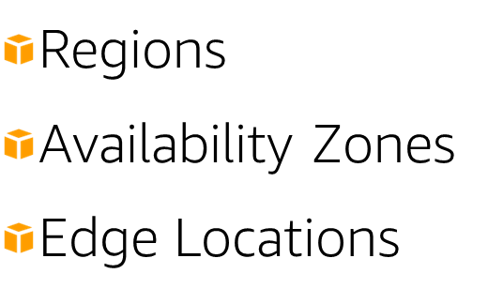
AWS Global Infrastructure
3
3
3
2
3
3
3
3
2
2
3
6
2
4
1
2
3
3
3
Notes:
Let’s review the AWS global infrastructure, which can be broken down into three topics:
Regions
Availability Zones
Edge Locations
Demo:
Navigate to AWS homepage and scroll to global network of regions and edge locations in the middle of the page. Edge locations can be displayed here: https://aws.amazon.com/CloudFront/details/
So let’s get started with Regions. Here at the AWS Homepage and if you scroll here to the middle, you will see a map of global network of Regions and Edge Locations.
Again, what are regions?
Regions are geographic areas that host two or more Availability Zones.
While building and choosing your custom services and features, you have the opportunity to choose in what geographical region your information will be stored.
When doing so, it is important to consider which Region will help you optimize latency while minimizing costs and adhering to whatever regulatory requirements you may have.
Let’s dive deeper here on this point. If you are leveraging cloud computing services you can easily deploy your application in multiple regions. For instance, you can have an application in a region nearest your headquarters such as San Diego and then also have a deployable application in a region in the East Coast. Let’s say your largest customer base is located in Virginia. Within a few clicks of your mouse, you can easily deploy in the US East region to provide a better experience for you while minimizing latency and increasing agility for your organization within minutes and with minimal cost!
Regions are completely separate entities from one another and resources in one region are not automatically replicated to other regions.

Slide 7
AWS Global Infrastructure 24 geographical regions, 1 local region, 77 availability zones, 200+ POPs
Region & Number of Availability Zones (AZs)
GovCloud (US) | Europe
US-East (3), US-West (3) | Frankfurt (3), Paris (3),
 | Ireland (3), Stockholm (3),
US West | London (3), Milan (3)
Oregon (4)
Northern California (3)
US East N. Virginia (6), Ohio (3) | Middle East Bahrain (3)
Canada | Asia Pacific
Central (3) | Singapore (3), Sydney (3),
 | Tokyo (4), Osaka-Local (1)*
South America São Paulo (3) | Seoul (4), Mumbai (3), Hong Kong (3)
Africa | China
Cape Town (3) | Beijing (2), Ningxia (3)
Announced Regions
Three Regions and 9 AZs in Indonesia, Japan, and Spain
* Available to select AWS customers who request access. Customers wishing to use the Asia Pacific (Osaka) Local Region should speak with their sales representative.
Notes:
[TALKING POINTS]
AWS has the largest global infrastructure footprint, with 24 Regions, 76 AZs with one or more data centers, and 216 points of presence (PoP), with 205 as Edge locations. And this footprint is constantly increasing - at a significant rate.
And this footprint is constantly increasing—at a significant rate.
AWS Global Infrastructure: https://aws.amazon.com/about-aws/global-infrastructure/?hp=tile
AWS CloudFront Locations: https://aws.amazon.com/cloudfront/details/
AWS Direct Connect Locations: https://aws.amazon.com/directconnect/details/
https://aws.amazon.com/cloudfront/features/
https://aws.amazon.com/about-aws/global-infrastructure/regional-product-services/

Slide 8
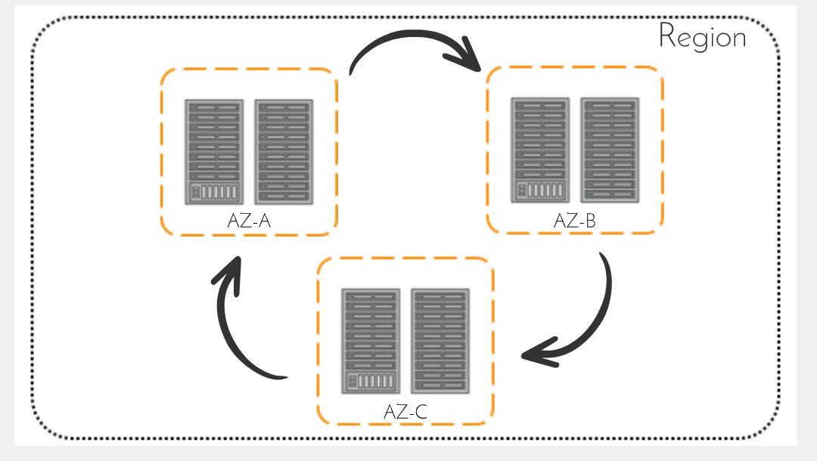

Availability Zones
Physically distinct
Region
Cooling equipment
Own uninterruptible power supply
Networking connectivity
Backup generators
Notes:
Next, lets talk about Availability Zones.
Availability Zones are a collection of data centers within a specific region.
Each are isolated from one another but yet they are connected together by a fast, low-latency link.
So what exactly is the benefit of having the Availability Zones isolated but also connected? When common points of failures occur, it does not affect all of your Availability Zones because they are isolated. How are they exactly isolated?
Each Availability Zone is a physically distinct, independent infrastructure. They are also physically and logically separate. Each zone has their own discrete uninterruptable power supply, onsite backup generators, cooling equipment, networking and connectivity. They are all supplied via different grids from independent utility companies, and connected through multiple tier-1 transit providers.

Slide 9
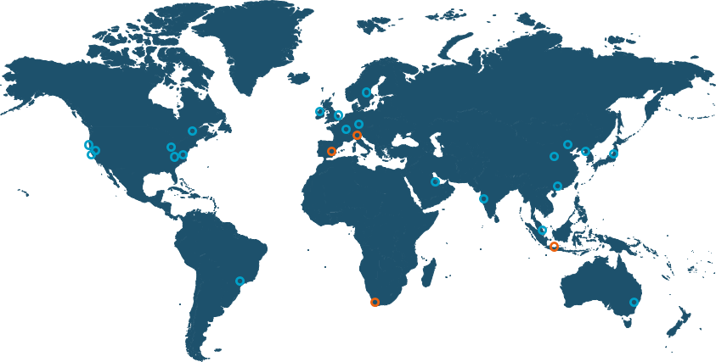
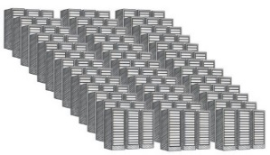
AWS region design
AWS Regions are comprised of multiple Availability Zones (AZs) for high availability, high scalability, and high fault tolerance. Applications and data are replicated in real time and consistent in the different AZs.
AWS Availability Zone (AZ)
AWS Region
Transit
AZ
Datacenter
Datacenter
AZ
AZ
Transit
AZ
Datacenter
A Region is a physical location in the world where we have multiple Availability Zones.
Availability Zones consist of one or more discrete data centers, each with redundant power, networking, and connectivity, housed in separate facilities.
Notes:
[TALKING POINTS]
Unlike other cloud infrastructure providers, each AWS Region has multiple Availability Zones and each AZ has multiple, physically separated data centers. By comparison, some cloud providers claim to have just over 50 regions, yet most of the regions have no AZs, and just one data center, so it is not comparable to the multi-AZ, multi-data center AWS Region.
Each region also has two independent, fully redundant transit centers that allow traffic to cross the AWS network, enabling regions to connect to the global network.
Further, we don’t use other backbone providers for AWS traffic once it hits our backbone.

Slide 10
Availability Zones
Isolating Availability Zones
Protects zones from failure
Designed for high availability
Handles requests through other zones
Best practice: Implement multiple Availability Zones
Notes:
Isolating them protects from failures in other Availability Zones to assist with high availability, and makes it possible for the other Availability Zones to handle requests.
AWS best practice is to provision your applications and data across multiple Availability Zones.

Slide 11
AWS Local Zones
AWS infrastructure deployment that places compute, storage, database, and other services closer to customers
For applications that require single-digit millisecond latencies
AWS infrastructure at the edge
Local compute, storage, databases, and other services
Connect to services in AWS Regions
Deliver new low latency apps

Slide 12
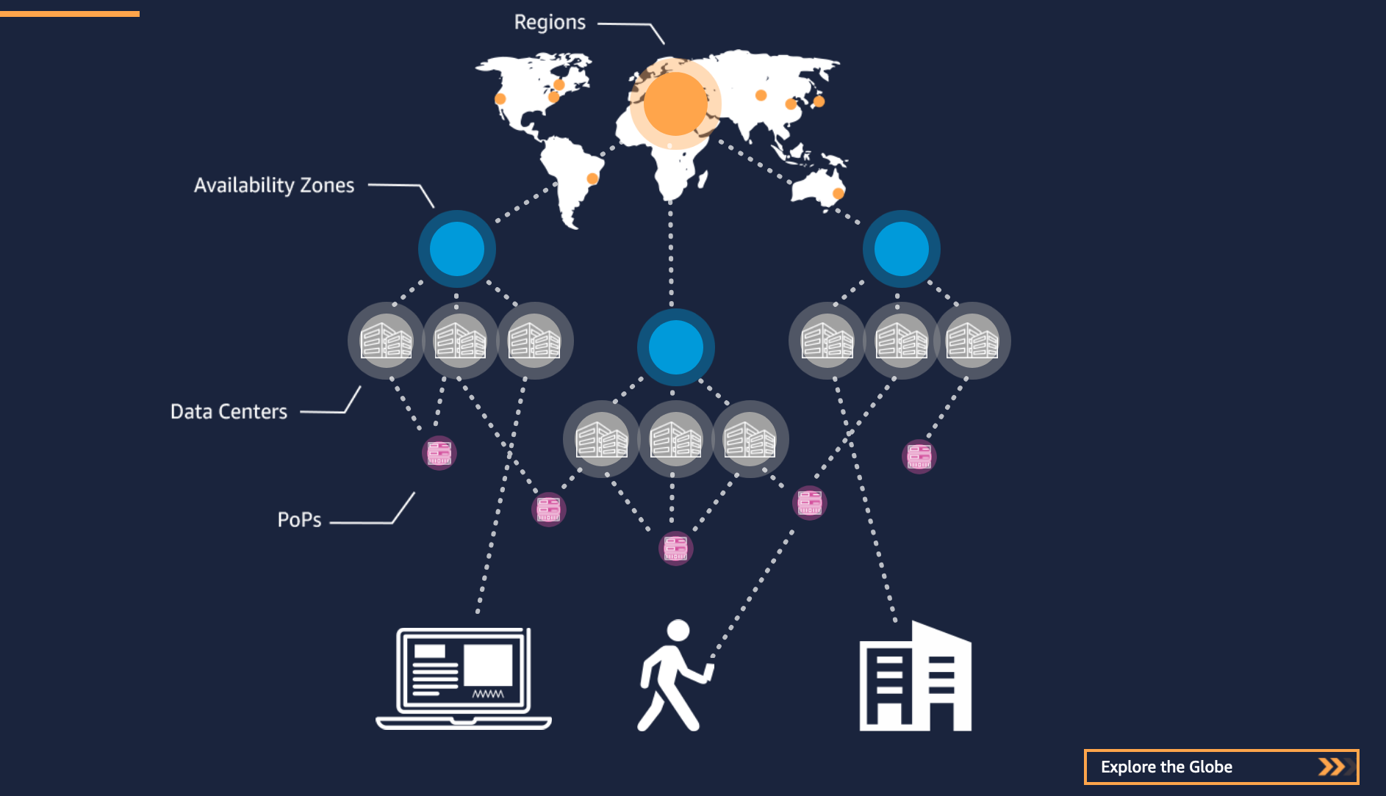
AWS Global Infrastructure
24 Regions
77 Availability Zones
Notes:
Today, AWS now spans 69 Availability Zones within 22 geographic regions around the world
Each AWS Region provides full redundancy and connectivity to the network. At AWS, Regions consist of multiple Availability Zones (AZ) (typically 3), each of which is a fully isolated partition of the AWS infrastructure that consists of discrete data centers.

Slide 13
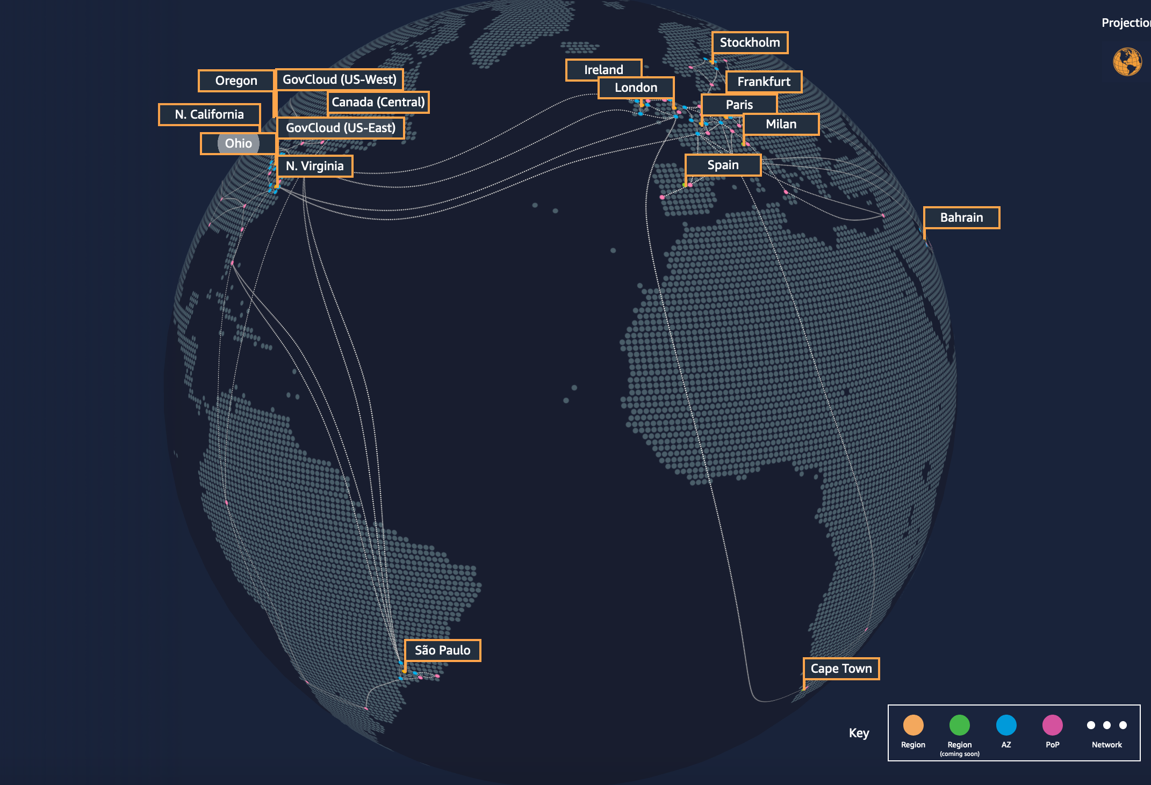
Latency-sensitive Workloads
Need increasing amounts of AWS Infrastructure and services closer to end-users
Notes:
Today, companies have a significant number of applications that they want to run in the AWS cloud.
Most work excellently in other public AWS regions; however, for some of their more latency-sensitive workloads – including remote real-time gaming, film production, and graphics-intensive virtual workstations – end-users need single digit millisecond latencies. For such demanding workloads, customers keep asking us to increase our global presence.
Otherwise, for these latency-sensitive workloads, companies have to procure, operate, and maintain IT infrastructure in their own data center or co-location facility. And, they have to build and run these low latency application components with a different set of APIs and tools than the other parts of their applications running in the AWS cloud. This result in a lot of extra effort and expense for these companies.

Slide 14
Benefits of AWS Local Zones
Consistent AWS Experience
Flexible and Scalable
Ultra-low Latency
Notes:
First, Low latency
AWS Local enable customers to open up new possibilities and deliver innovative applications and services that require single-digit millisecond latencies for more end users.
Next, Consistent AWS experience
AWS Local Zones enable customers to use the same AWS infrastructure, services, APIs, and tool sets that they are familiar with in the cloud. Their applications have fast, secure, and seamless access to the full breadth of services in the parent region.
Lastly, Flexible and scalable
AWS Local Zones are part of AWS Global Infrastructure, thereby offering the benefits AWS Regions offer today, like elasticity, availability, selection, and low pay-as-you-go pricing. Customers can start small and scale as your needs grow, and pay only for the resources that they use.

Slide 15
Edge Locations
Amazon CloudFront
Amazon Route 53
AWS Shield
AWS Web Application Firewall
Lambda@Edge Computing
Notes:
Amazon CloudFront is used to deliver content to your customers. Requests for content are automatically routed to the nearest edge location so that the content is delivered faster to the end users.
Utilizing the global network of edge locations and regions, you have access to quicker content delivery. Edge locations are typically located in highly populated areas similar to regions and availability zones. For a full list of locations, see: http://aws.amazon.com/CloudFront/details.
In addition to CloudFront, Amazon Route 53, AWS Shield, and AWS WAF services are offered at AWS Edge Locations.
Apart from increasing speed and reducing latency, one of the most important roles of an Edge Location is offering security at the edge before reaching your data hosted in regions.

Slide 16
Amazon Virtual Private Cloud (VPC)

Slide 17
Introduction
Private, virtual network in the AWS Cloud
Similar constructs as on-premises network
Customizable network configurations to your needs
Notes:
The AWS cloud offers pay-as-you-go, on-demand compute and managed services, all accessible via the web. These compute resources and services must be accessible via normal IP protocols implemented with familiar network structures. Customers need to adhere to networking best practices and meet regulatory and organizational requirements. Amazon Virtual Private Cloud, or VPC, is the networking AWS service that will meet your networking requirements.
Amazon VPC allows you to create a private network within the AWS cloud that uses many of the same concepts and constructs as an on-premises network, but as you will see later, much of the complexity of setting up a network has been abstracted without sacrificing control, security, and usability. Amazon VPC also gives you complete control of the network configuration. You can define normal networking configuration items such as IP address spaces, subnets, and routing tables. This allows you to control what you expose to the internet and what you isolate within the Amazon VPC.

Slide 18
Deployment
Layer security controls in deployment
Multiple AWS services that inherit the security deployed
Notes:
You can deploy your Amazon VPC in a way to layer security controls in the network. This includes isolating subnets, defining access control lists, and customizing routing rules. You have complete control to allow and deny both incoming and outgoing traffic. Finally, there are numerous AWS services that deploy into your Amazon VPC that then inherit and take advantage of the security that you have built into your cloud network.

Slide 19
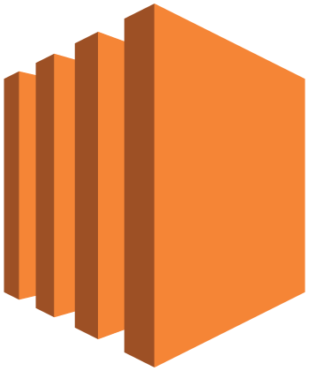



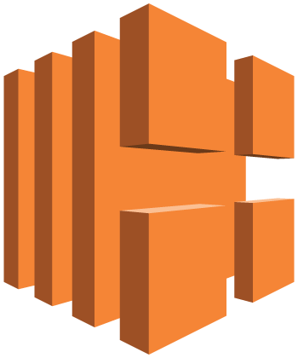
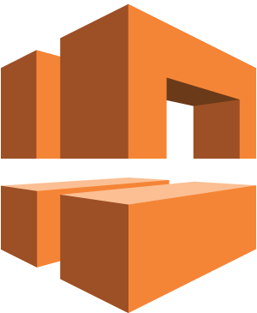

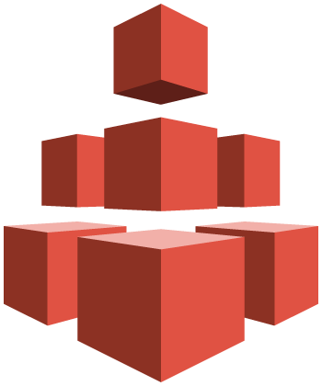


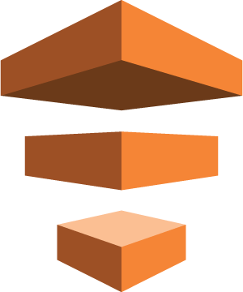




Introduction
Amazon EC2
Amazon EMR
Amazon RDS
Amazon WorkSpaces
Elastic Load Balancing
Amazon VPC
AWS OpsWorks
Amazon EFS
AWS Elastic Beanstalk
Amazon Route 53
AWS Data Pipeline
Amazon S3
Amazon DynamoDB
Amazon ElastiCache
AWS Directory Service
Notes:
Amazon VPC is an AWS foundational service and integrates with numerous AWS services. For instance, Amazon Elastic Cloud Compute (Amazon EC2) instances are deployed into your Amazon VPC. Similarly, Amazon Relational Database Service (Amazon RDS) database instances deploy into your VPC, where the database is protected by the structure of the network just like your on-premises network. Understanding and implementing Amazon VPC will allow you to fully use other AWS services.

Slide 20
Features
Characteristics
Allows you to provision virtual networks
Logically isolated
Configurable key features
IP ranges
Routing
Network gateways
Security settings
Route Tables
Control traffic going out of the subnets
Notes:
Let's take a look at the features of Amazon VPC. Amazon VPC builds upon the AWS global infrastructure of regions and Availability Zones, and allows you to easily take advantage of the high availability provided by the AWS cloud. It also allows you to provision virtual networks hosted on the AWS cloud and dedicate to your AWS account. Amazon VPCs live within regions. Each AWS account can create multiple VPCs that can be used to segregate environments. A VPC defines an IP address space that is then divided by subnets. VPCs are logically isolated from other virtual networks.
You can create many subnets in a VPC, though fewer is recommended to limit the complexity of the network topology, but this is totally up to you. You can configure route tables for your subnets to control the traffic between subnets and the Internet. By default, all subnets within a VPC can communicate with each other.
Subnets are generally classified as public or private, with public having direct access to the internet and private not having direct access to the internet. For a subnet to be public, you need to attach an internet gateway to the VPC and update the route table of the public subnet to send non-local traffic to the internet gateway. Amazon EC2 instances also must have a public IP address to route to an internet gateway.

Slide 21
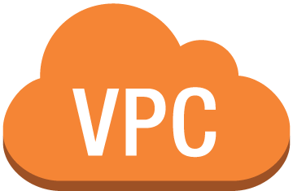
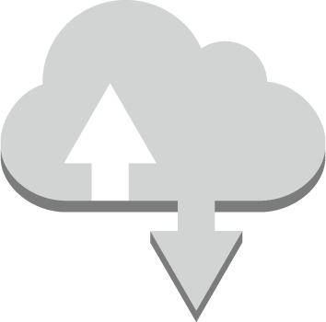

Example
Test- VPC 10.0.0.0/16
10.0.0.0/24
Test- IGW
Public Subnet A1
10.0.1.0/24
Private Subnet B1
Availability Zone A
us-west-2 (Oregon)
Notes:
You have added an internet gateway called Test IGW. Subnet A1 will become a public subnet where non-local traffic is routed through the internet gateway. Subnet B1 will be your private subnet that is isolated from the internet.

Slide 22
AWS Security Groups

Slide 23

AWS Security
Is the highest priorities
Security groups
Act as built-in firewalls
Control accessibility to instances
Notes:
Security of the AWS Cloud is one of Amazon Web Services highest priorities, and there are many robust security options to help you secure your data in the AWS Cloud.
One of the features you’ll learn about is security groups.
At AWS, security groups will act like a built-in firewall for your virtual servers. With these security groups, you have full control on how accessible your instances are.
At the most basic level, it is just another method to filter traffic to your instances. It provides you control on what traffic comes can pass or not. To determine who has access to your instances, you would configure a security group rule. Rules can vary from keeping the instance completely private, totally public, or somewhere in between.

Slide 24



AWS Security
Corporate
Admin Network
ssh/rdp
ssh/rdp
ssh/rdp
www server
app server
db server
www server
app server
db server
internet
http/https
www server
app server
db server
api
api
Web Tier
security group
Application Tier
security group
Database Tier
security group
(all other ports are blocked)
Notes:
Here is an example of a classic AWS multi-tier security group example. In this architecture, notice that multiple different security group rules have been created to accommodate this multi-tiered web architecture.
If you start at the web tier, there is a rule set up to accept traffic from anywhere on the internet on port 80/443 by selecting the source of 0.0.0.0/0.
Next if you move to the app tier, there is a security group that only accepts traffic from the web tier, and similarly, the database tier can only accept traffic from the app tier.
Finally, there has also been a rule created to allow administration remotely from the corporate network over SSH port 22.

Slide 25
Summary
Amazon EC2 Security groups
Provide virtual firewalls
Control access to instances through rules
Are managed through AWS management console
Notes:
Let’s go over what was discussed today. AWS provides virtual firewalls that can control traffic for one or more instances, called security groups. You can control accessibility to your instances by creating security group rules. These security groups can be managed in the AWS management console.

Slide 26
Compute Services

Slide 27
Compute Services
Broad catalog
Application services
Virtual private servers
Serverless computing
Notes:
Building and running your business starts with compute, whether you're building mobile apps or running massive clusters to sequence the human genome. AWS has a broad catalog of compute services. Everything from simple application services to flexible virtual servers, and even serverless computing. In this lesson, you will learn compute services.

Slide 28
Compute Services
AWS
Flexible
Cost effective
Amazon EC2
Flexible configuration and control
AWS Lambda
Pay only for what you use
No administration
Notes:
Running servers on premises is an expensive undertaking. Hardware must be procured, often based upon project plans, not the reality of usage. Data centers are expensive to build, staff, and maintain. You need to provision resources for the worst case. Your servers must be able to handle traffic spikes and events. After built out, you often have capacity lying idle.
AWS offers flexibility and cost effectiveness. With AWS, you can scale your compute needs to your workload. Scalability is built into our compute services so that as demand increases, you can easily scale up. If demand drops, say at night or on weekends, you can scale down to save money and resources. You don't need to pay for what you're not using.
Computing needs may change over time and our Amazon EC2 service, for example, offers a wide variety of virtual server instance types that are appropriate for everything from simple web servers to large machine learning clusters. You're not locked into specific hardware configurations that you purchased and can easily change instance types. Amazon EC2 allows you complete flexibility to run applications at any scale. You maintain complete control over your environment, and unlike an on-premises environment, with On-Demand pricing, you can cost-effectively scale resources up and down to meet your needs.
You don’t always have to run a server. What if instead of running servers, you could just run your application when needed? AWS Lambda lets you run code without provisioning or managing servers. You pay only for the compute time you consume. There's no charge when your code's not running. With Lambda, you can run code for virtually any type of application or backend service: mobile, Internet of Things (IoT), streaming services — all with zero administration. For example, say I want to process an uploaded image. I can upload the image to Amazon S3 (which is a service that allows you to store objects and can retrieve any amount of data from anywhere) and use an event trigger to launch a Lambda function to process that image without having to have an idle server standing by. Think about it the ease of running compute without having to provision and maintain servers.

Slide 29
Compute Services
Amazon Lightsail
Launch virtual private server
Manage simple web and application servers
Amazon ECS
Managed containers
Highly scalable, high performance
AWS Fargate
Amazon EKS
Notes:
If you need to run a simple website or e-commerce applications, AWS offers Amazon Lightsail. With Lightsail, you can launch a virtual private server in just minutes and easily manage simple web and application servers. Lightsail includes everything you to jump-start your project — a virtual machine, SSD-based storage, data transfer, DNS management, and a static IP address—for a low, predictable price.
Do you use container services on premises? Amazon Elastic Container Service (Amazon ECS) is a highly scalable, high-performance container management service that supports Docker containers and allows you to easily run applications on a managed cluster of Amazon EC2 instances. Amazon ECS eliminates the need for you to install, operate, and scale your own cluster management infrastructure. AWS offers multiple compute products, allowing you to deploy, run, and scale your applications as virtual servers or containers, or code. You have services available to you for automating and scaling batch processing, running and managing web applications, and creating virtual networks. Additional information about AWS compute services is available at https://www.aws.amazon.com/products/compute. There is also have a full set of service-level introductions available for you to learn the details of each of these services.
AWS Fargate is a technology for Amazon ECS (Amazon Elastic Container Service) and EKS (Amazon Elastic Container Service for Kubernetes) that allows users to run containers without having to manage servers or clusters. It removes the need to interact with or think about servers or clusters.
Amazon EKS or Amazon Elastic Container Service for Kubernetes is a managed service that makes it simple to run Kubernetes on AWS without needing to install/operate your own Kubernetes clusters. Kubernetes is an open source platform that is used for managing containerized applications and workloads.

Slide 30
Amazon Elastic Compute Cloud (EC2)

Slide 31

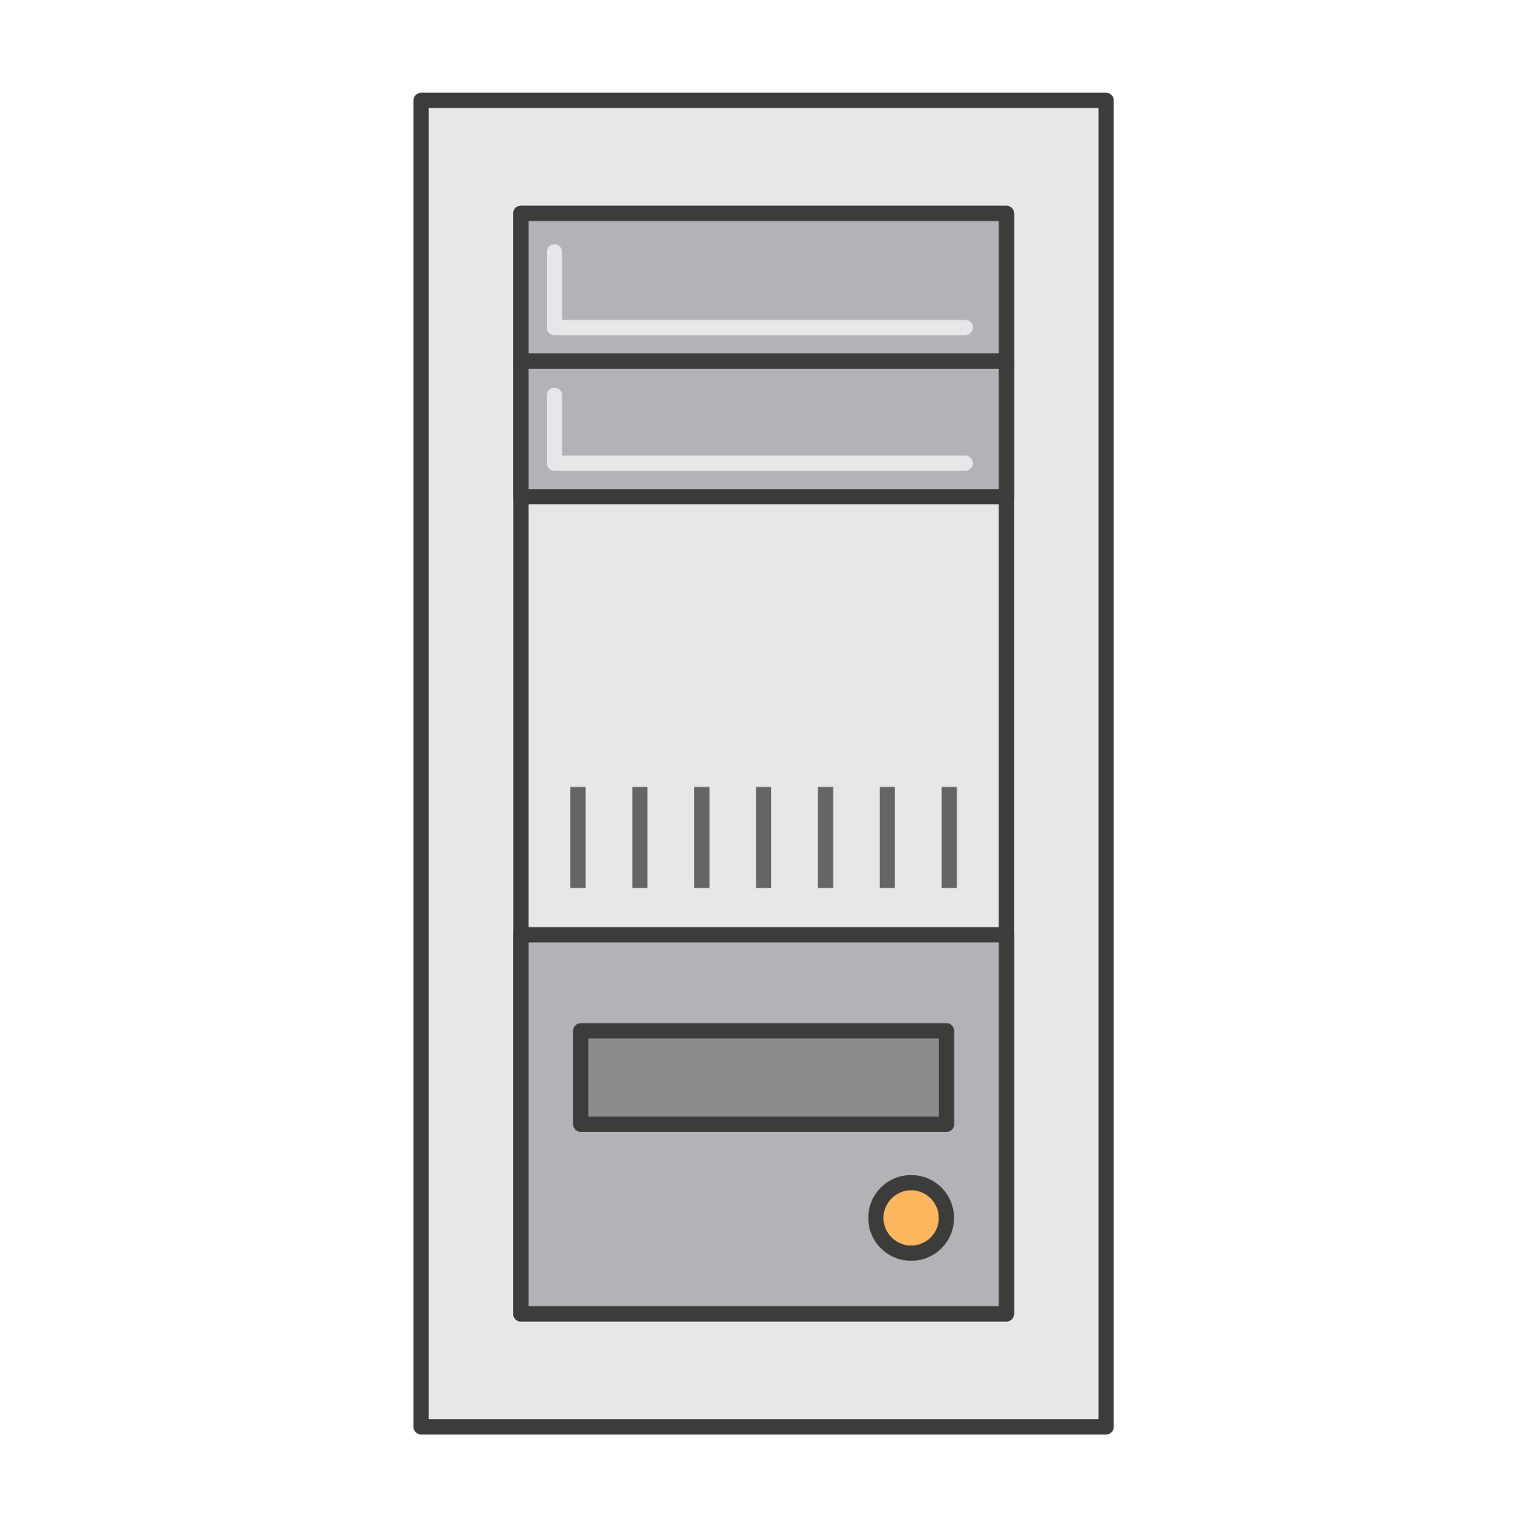
What is Amazon EC2?
Elastic Compute Cloud
Application Server
Web Server
Database Server
Game Server
Mail Server
Media Server
Catalog Server
File Server
Computing Server
Proxy Server
Notes:
First, what is Amazon EC2? It stands for Elastic Compute Cloud.
Compute refers to the server resources that are being presented. There's a lot of different fun and exciting things you can do with servers.
Cloud refers to the fact that these are cloud-hosted compute resources.
Elastic refers to the fact that if properly configured, you can increase or decrease the amount of servers required by an application automatically, according to the current demands on that application.

Slide 32
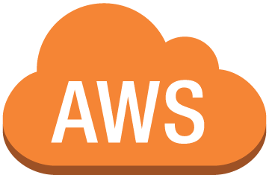

What is Amazon EC2?
Amazon EC2 Instances
Pay as you go
Broad selection of HW/SW
Global hosting
Much more (aws.amazon.com/ec2)
Notes:
But let's stop calling them servers and use the proper name of Amazon EC2 instances. Instances are pay-as-you-go. You pay for running instances and for the time that they're running. Provided with Amazon EC2 instances are a broad selection of hardware and software, and selection of where to host your instances.

Slide 33

Product Demonstration
Login to AWS console.
Launch EC2 Wizard.
Select AMI (SW).
Select Instance type (HW).
Configure network.
Configure storage.
Collect private key.
Launch.
Connect.
Notes:
Now I'd like to demonstrate how to build and configure an EC2 instance, and during that process, I'd like to go into detail about the topics that we've covered so far. During the demonstration, you’ll log to the AWS Management Console, choose a region where we're going to host our instance, launch the EC2 wizard, select an AMI, which stands for Amazon Machine Image, providing us with a software platform for our instance. Then we'll select the instance type, referring to the hardware capabilities. Then we'll configure network, storage, and finally key pairs which will allow us to connect to the instance after we’ve launched and connect to it.

Slide 34
Instance Types
Families | Description | Example Use Cases
t2, m4, m3 | General Purpose Balanced Performance | Websites, web applications, Dev, code repos, micro services, business apps
c3, c4, cc2 | Compute Optimized High CPU Performance | Front-end fleets, web-servers, batch processing, distributed analytics, science and engineering apps, ad serving, MMO gaming, video-encoding
g2, p2 | GPU Optimized High-end GPU | Amazon AppStream 2.0, video encoding, machine learning, high perf databases, science
r3, r4, x1, cr1 | Memory Optimized Large RAM footprint | In-memory databases, data mining
d2, i2, i3, hi1, hs1 | Storage Optimized High I/O, High density | NAS, data warehousing, NoSQL
Notes:
Here are some of the instance types. For more information, see: https://www.aws.amazon.com/ec2/instance-types.

Slide 35

Choosing the Right Amazon EC2 Instances
EC2 Instance types are optimized for different use cases, workloads & come in multiple sizes. This allows you to optimally scale resources to your workload requirements.
AWS utilizes Intel® Xeon® processors for EC2 Instances providing customers with high performance and value.
Consider the following when choosing your instances: core count, memory size, storage size & type, network performance, I/O requirements & CPU technologies.
Hurry Up & Go Idle - A larger compute instance can save you time and money, therefore paying more per hour for a shorter amount of time can be less expensive.

Slide 36
EC2 Instances Powered by Intel Technologies
EC2 Instance Type | Compute Optimized |  | General Purpose |  |  | Memory Optimized |  |  | Storage Optimized
 | C5 | C4 | M5 | M4 | T2 | X1 | X1e | R4 | H1 | I3 | D2
Intel Processor | Xeon Platinum 8175M | Xeon E5 2666 v3 | Xeon Platinum 8175M | Xeon E5 2686 v4 2676 v3 | Xeon Family | Xeon E7 8880 v3 | Xeon E7 8880 v3 | Xeon E5 2686 v4 | Xeon E5 2686 v4 | Xeon E5 2686 v4 | Xeon E5 2676 v3
Intel Processor Technology | Skylake | Haswell | Skylake | Broadwell Haswell | Yes | Haswell | Haswell | Broadwell | Broadwell | Broadwell | Haswell
Intel AVX | Yes | Yes | Yes | Yes | Yes | Yes | Yes | Yes | Yes | Yes | Yes
Intel AVX2 | Yes | Yes | Yes | Yes | - | Yes | Yes | Yes | Yes | Yes | Yes
Intel AVX-512 | Yes | - | Yes | - | - | - | - | - | - | - | -
Intel Turbo Boost | Yes | Yes | Yes | Yes | Yes | Yes | Yes | Yes | Yes | Yes | Yes
Storage | EBS-only | EBS-only | EBS-only | EBS-only | EBS-only | SSD EBS-Opt | SSD EBS-Opt | - | HDD | SSD | HDD

Slide 37
C5: Compute Optimized Instances
Based on 3.0 GHz Intel Xeon Scalable Processors (Skylake)
Up to 72 vCPUs and 144 GiB of memory (2:1 Memory:vCPU ratio)
25 Gbps NW bandwidth
Support for Intel AVX-512
“We saw significant performance improvement on Amazon EC2 C5, with up to a 140% performance improvement in industry standard CPU benchmarks over C4.”
“We are eager to migrate onto the AVX-512 enabled c5.18xlarge instance size… . We expect to decrease the processing time of some of our key workloads by more than 30%.”
Notes:
C5 instances are designed for compute-heavy applications like batch processing, distributed analytics, high-performance computing (HPC), ad serving, highly scalable multiplayer gaming, and video encoding. The new instances offer a 25% price/performance improvement over the C4 instances, with over 50% for some workloads. They also have additional memory per vCPU, and (for code that can make use of the new AVX-512 instructions), twice the performance for vector and floating point workloads.
Over the years we have been working non-stop to provide our customers with the best possible networking, storage, and compute performance, with a long-term focus on offloading many types of work to dedicated hardware designed and built by AWS. The C5 instance type incorporates the latest generation of our hardware offloads, and also takes another big step forward with the addition of a new hypervisor that runs hand-in-glove with our hardware. The new hypervisor allows us to give you access to all of the processing power provided by the host hardware, while also making performance even more consistent and further raising the bar on security.

Slide 38
M5: Next-Gen General Purpose instance
Powered by 2.5 GHz Intel Xeon Scalable Processors (Skylake)
New larger instance size—m5.24xlarge with 96 vCPUs and 384 GiB of memory (4:1 Memory:vCPU ratio)
Improved network and EBS performance on smaller instance sizes
Support for Intel AVX-512 offering up to twice the performance for vector and floating point workloads
Notes:
The general-purpose (M) instances go all the way back to 2006 when we launched the m1.small. We continued to evolve along this branch of our family tree, launching the M2 (2009), M3 (2012), and the M4 (2015) instances. Our customers use the general-purpose instances to run web & app servers, host enterprise applications, support online games, and build cache fleets.
Available now, M5 instances are the next generation of Amazon EC2 General Purpose instances, powered by 2.5 GHz Intel Xeon Platinum 8000 series (Skylake-SP) processors. With Enhanced Networking, and a new larger instance size that provides up to 96 vCPUs and 384 GiB of memory, M5 instances have up to 50 percent more vCPUs, 50 percent more memory, and 25 percent more network bandwidth than M4, making them ideal for web and application servers, backend enterprise applications, gaming servers, caching fleets, and application development environments.

Slide 39
Amazon Elastic Block Store (EBS)

Slide 40
EBS Volumes
Characteristics
Persistent and customizable block storage for EC2 instances
HDD and SSD types
Use Snapshots for backups
Easy and transparent encryption
Elastic
Notes:
EBS volumes can be used as a storage unit for your Amazon EC2 instances, so whenever you think you must have disk space for your instances running on AWS, you can use them. These volumes can be hard disks or SSD devices, and you pay as you use—so whenever you don't need a volume anymore, you can just delete it.

Slide 41
EBS Volumes
Availability
Durable and automatically replicated
Drive Types
Storage that best fits your needs
Magnetic or SSD
Performance and price requirements
Notes:
EBS volumes are designed for being durable and available. This means that the data in a volume is automatically replicated across multiple servers running in the Availability Zone.
I made the comparison about EBS volumes and physical media devices like hard disks or SSDs, but it's actually much more durable than that because of the block-level replication. While creating an EBS volume, you can select the type of storage that best fits your needs. You can choose between magnetic or SSD, based on your performance and price requirements. It's all about choosing the right tool for the right job, so for example, if you are running a database instance, you can configure the database to use a secondary volume for the data—which may perform faster than the volume assigned to the operating system. Or you can assign a magnetic volume for the logs, because magnetic is cheaper.

Slide 42



Amazon EBS
Snapshots
Point-in-time snapshots
Recreate a new volume at any time
Encryption
Encrypted EBS volumes
No additional cost
Elasticity
Increase capacity
Change to different types
Notes:
To provide an even higher level of data durability, Amazon EBS gives you the ability to create point-in-time snapshots of your volumes, and AWS allows you to recreate a new volume from a snapshot at any time. Share snapshots or even copy snapshots [to] different AWS Regions for even greater disaster recovery (DR) protection. You can, for example, encrypt and share your snapshots from Virginia to Tokyo.
You could also have encrypted EBS volumes at no additional cost. The encryption occurs on the EC2 side, so the data moving between the EC2 instance and the EBS volume inside AWS data centers will be encrypted in transit.
When your company grows, the amount of data stored on your EBS volumes will probably also grow. EBS volumes have the ability to increase capacity and change to different types, meaning that you can change from hard disk to SSD or increase from a 50-gigabyte volume to a 16-terabyte volume. For example, you can do this sizable operation on the fly without having to stop the instances. So let me do a demonstration to show you how fast and easy it is to create a new volume and attach that volume into an EC2 instance.

Slide 43
Summary
Features
Persistent and customizable block storage for EC2 instances
HDD and SSD types
Replicated in the same Availability Zones
Easy and transparent encryption
Elastic volumes
Back up using snapshots
Notes:
And that's it. In summary, you’ve reviewed what EBS volumes are, and you saw a demo on how to create and attach one EBS volume to a Linux EC2 instance.

Slide 44
Amazon Simple Storage Service (S3)

Slide 45
Amazon S3
Features
Fully managed cloud storage service
Rich security controls
Functionality
Store virtually unlimited number of objects
Access any time, from anywhere
Notes:
Amazon S3 is a fully managed storage service that provides a simple API for storing and retrieving data. This means that the data you store in S3 isn't associated with any particular server, and you don't have to manage any infrastructure yourself. You can put as many objects into S3 as you want. S3 holds trillions of objects and regularly peaks at millions of requests per second.
Objects can be almost any data file, such as images, videos, or server logs. S3 supports objects as large as several terabytes in size, you could even store database snapshots as objects. Amazon S3 also provides low-latency access to the data over the internet by HTTP or HTTPS, so you can retrieve data anytime from anywhere. You can also access S3 privately through a virtual private cloud endpoint. You get fine-grained control over who can access your data using identity and access management policies, S3 bucket policies, and even per-object access control lists.
By default, none of your data is shared publicly. You can also encrypt your data in transit and choose to enable server-side encryption on your objects.

Slide 46
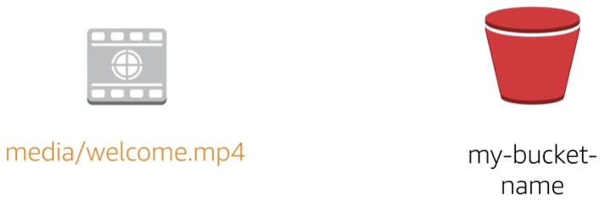
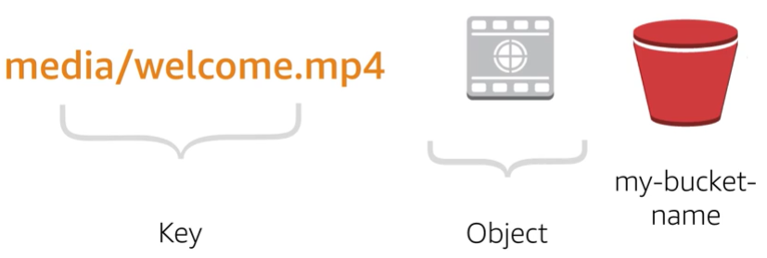
Getting Started with S3
media/welcome.mp4
my-bucket-name
media/welcome.mp4
Key
Object
my-bucket-name
Notes:
Let's take a file that needs to be stored, such as this Welcome video. First, you have to have a place to put it. In S3, you can create a bucket to hold your data.
When you want to put this video into our bucket as an object, you have to specify a key, which is just a string that can be used to retrieve the object later. A common practice is to set these strings in a way that resembles a file path. Let's put the video into S3 as an object with the corresponding key.

Slide 47
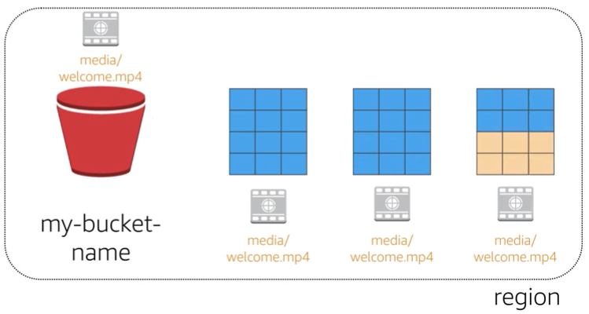
Data redundantly stored in region
media/welcome.mp4
my-bucket-name
media/welcome.mp4
media/welcome.mp4
media/welcome.mp4
region
Notes:
While you create a bucket in S3, it's associated with a particular AWS region. Whenever you store data in the bucket, it is redundantly stored across multiple AWS facilities within your selected region. The S3 service is designed to durably store your data, even in the case of concurrent data loss in two AWS facilities

Slide 48
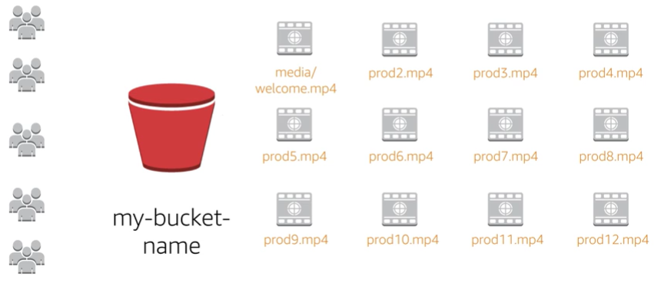
Designed for seamless scaling
media/welcome.mp4
prod2.mp4
prod3.mp4
prod4.mp4
prod5.mp4
prod6.mp4
prod7.mp4
prod8.mp4
my-bucket-name
prod9.mp4
prod10.mp4
prod11.mp4
prod12.mp4
Notes:
S3 will automatically manage the storage behind your bucket even as your data grows. This allows you to get started immediately and to have your data storage grow with your application needs. S3 will also scale to handle a high volume of requests. You don't have to provision the storage or throughput, and you'll only be billed for what you use.

Slide 49
Access the Data Anywhere
AWS Management Console
AWS command line interface
AWS software development kits
Notes:
You can access S3 by the management console, AWS CLI, or AWS SDK. Additionally, you can also access the data in your bucket directly via the rest endpoints. These support HTTP or HTTPS access.

Slide 50
Common Use Cases
Storing application assets
Static web hosting
Backup and disaster recovery (DR)
Staging area for big data
Notes:
This flexibility to store a virtually unlimited amount of data and access that data from anywhere makes the S3 service suitable for a wide range of scenarios. Let's look at some use cases for S3.
As a location for any application data, S3 buckets provide that shared location for storing objects that any instances of your application can access, including applications on EC2 or even traditional servers. This can be useful for user-generated media files, server logs, or other files your application needs to store in a common location. Also, because the content can be fetched directly over the web, you can offload serving of that content from your application and allow clients to directly fetch the data themselves from S3. For static web hosting, S3 buckets can serve up the static contents of your website, including HTML, CSS, javascript, and other files.
The high durability of S3 makes it a good candidate to store backups of your data. For even greater availability and disaster recovery capability, S3 can even be configured to support cross-region replication such that data put into an S3 bucket in one region can be automatically replicated to another S3 region. The scalable storage and performance of S3 make it a great candidate for staging or long-term storage of data you plan to analyze using a variety of big data tools.

Slide 51
Summary
Fully managed cloud storage service
Store virtually unlimited number of objects
Access any time, from anywhere
Rich security controls
Common use cases
Notes:
In this training, we've covered an introduction to S3 and some common use cases. In the demo, you got to go hands-on with creating a bucket, copying files into the bucket, and then downloading those files from an EC2 instance.

Slide 52
© 2018 Amazon Web Services, Inc. or its affiliates. All rights reserved. This work may not be reproduced or redistributed, in whole or in part, without prior written permission from Amazon Web Services, Inc. Commercial copying, lending, or selling is prohibited. Corrections or feedback on the course, please email us at: aws-course-feedback@amazon.com. For all other questions, contact us at: https://aws.amazon.com/contact-us/aws-training/. All trademarks are the property of their owners.

